Slide 1
MOVIE RECOMMENDER SYSTEM
Jan 2022
By Kent, Daniel & Eddie

Slide 2
Table of contents
01
02
03
04
EDA On Data Set
Content Based Filtering
Collaborative Filtering
Matrix Factorization
05
Recommendation Engines Evaluation
Hybrid Recommender Engine
06

Slide 3
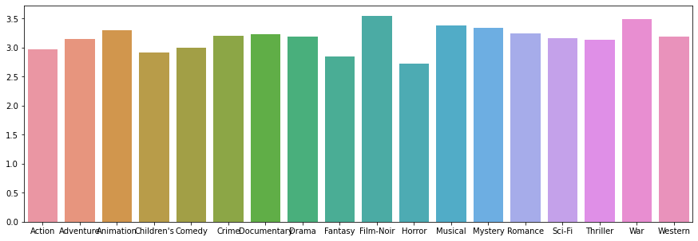
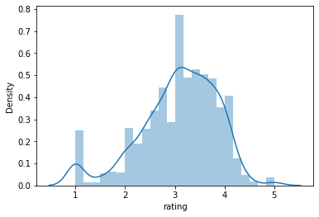
EDA on Data Set
Overview of our Data Set:
100,000 ratings by 943 users on 1682 movie items
Each user has rated at least 2 movies, no significant duplicate or missing values
Distribution by genre
Distribution by ratings

Slide 4
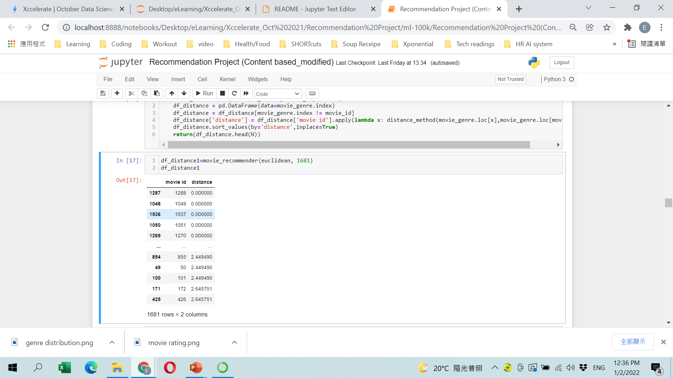
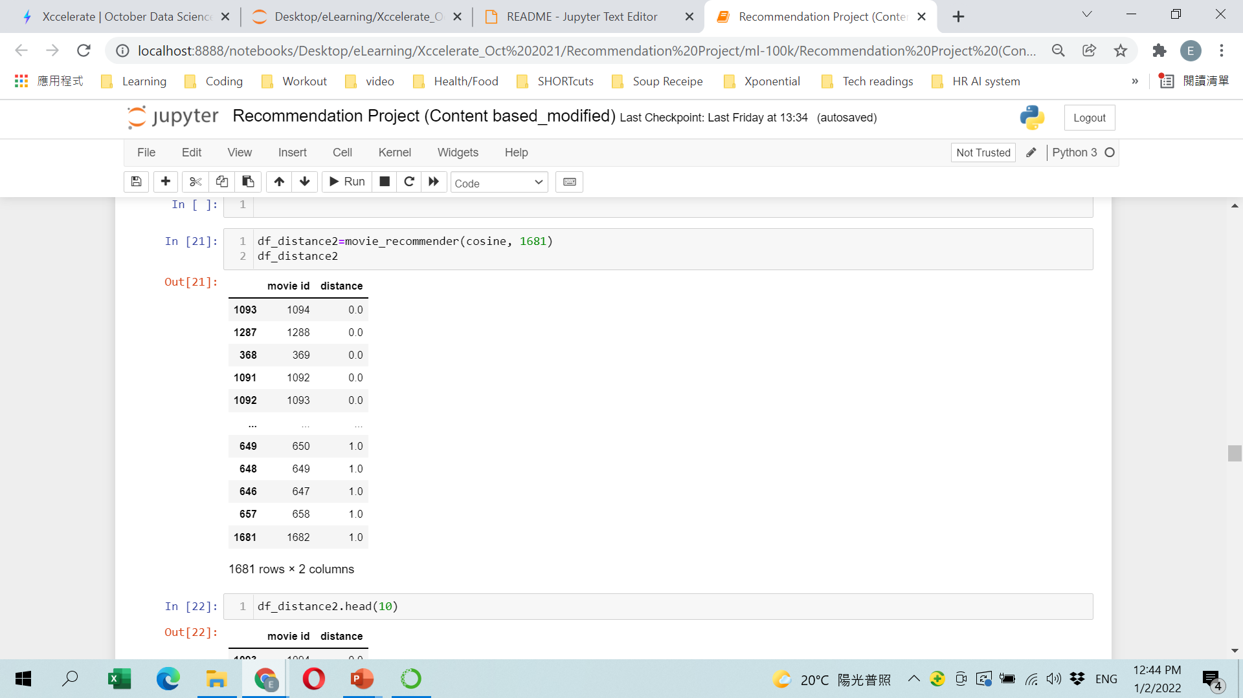
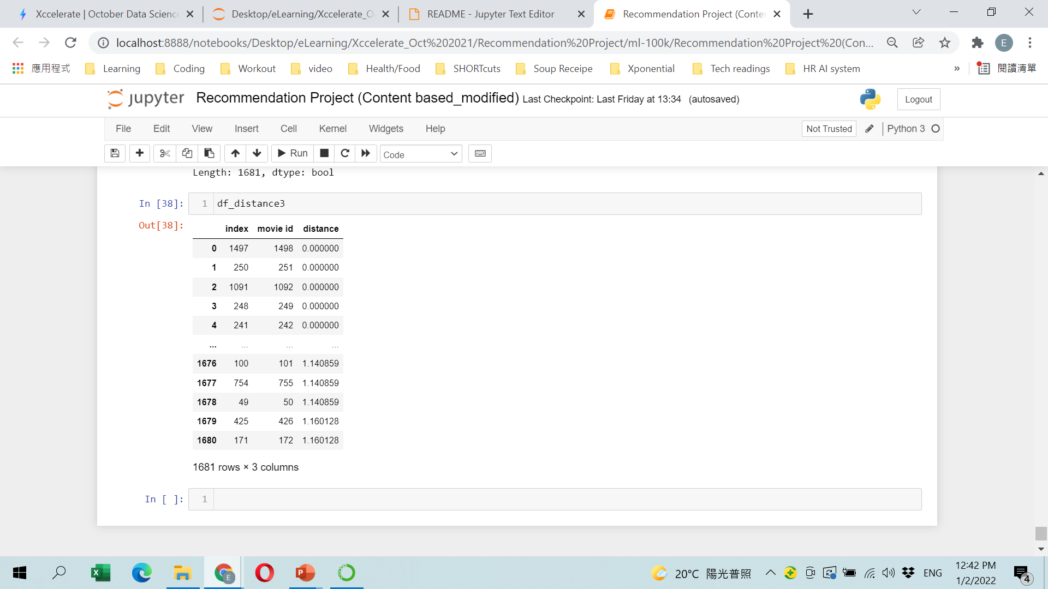
Content-Based Filtering
Euclidean Distance
Cosine Similarity
Pearson’s Correlation
Basic
Pro

Slide 5
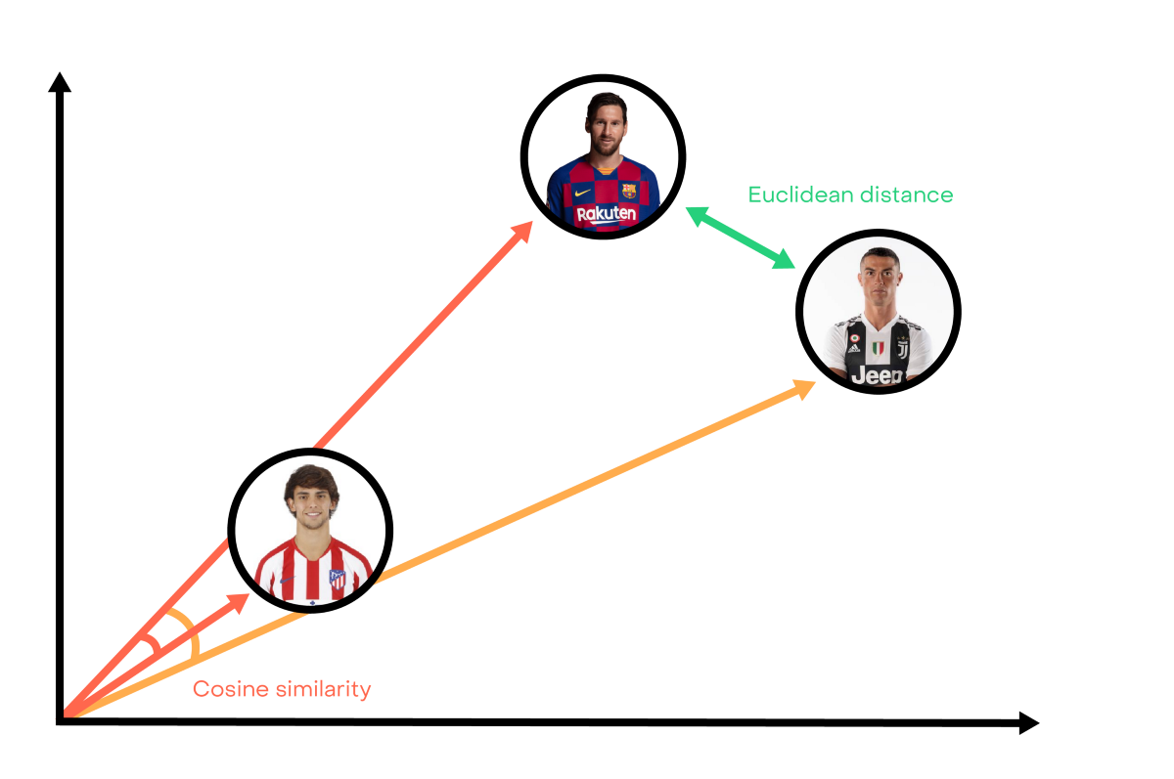
Content-Based Filtering

Slide 6
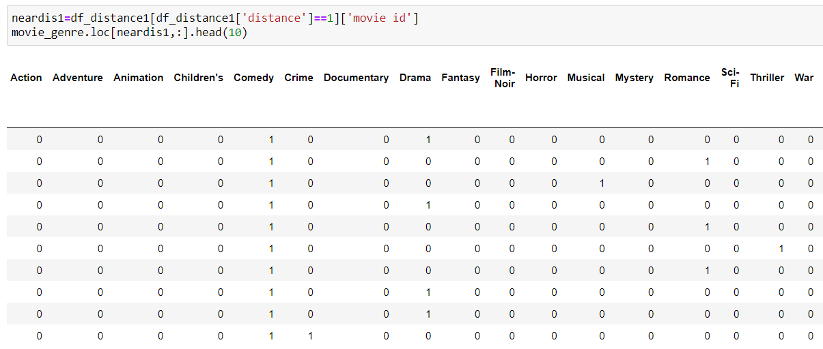
Content-Based Filtering
Euclidean Distance
M2
M6

Slide 7
COMPARISON OF METHODS
 | ADVANTAGES | DISADVANTAGES
Euclidean | Intuitive to use; easy to implement Works well on low dimensional data & when size of vector is important | Euclidean distance is the similarity of actual value; becomes less useful as data dimension increases
Cosine | Good to solve problem with high dimensional distance | Doesn't consider the size of the vector, just consider about direction (disregard difference of scoring scale between different users)
Correlation | More often used on collaborative filtering; (user-user or item-item based) Effective in evaluating linear relationship between two variables | Assumes that there is always a linear relationship between the variables which might not be the case all the times

Slide 8

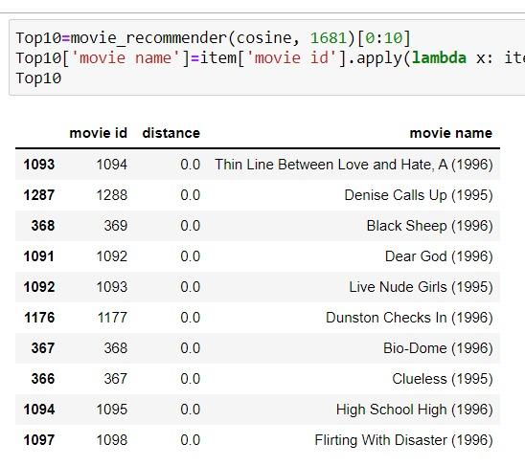
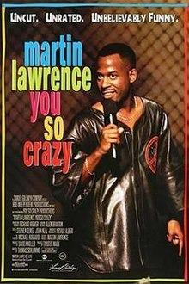

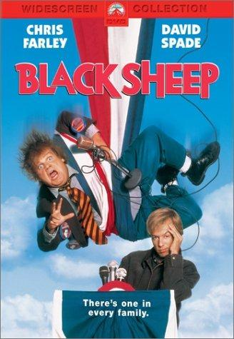
Top 10 Movies recommendation

Slide 9
COLLABORATIVE FILTERING SYSTEM
 | User-User | Item-Item
Description | Find look alike users based on similarity and recommend movies which first user’s look-alike has chosen in past | Looks for similar items based on the items users have already liked or positively interacted with.
Pros | Easy to implement Context independent Compared to other techniques, such as content-based, it is more accurate | Solve issues that user-based collaborative filters suffer from; such as when the system has many items with fewer items rated Less computation intensive than UBCF
Cons | Sparsity: The percentage of people who rate items is usually low. Scalability: More users means greater computing power to find the nearest K neighbors Cold-start: New users will have no to little information about them to be compared with other users. | New item: New items will have lack of ratings to create a solid ranking

Slide 10
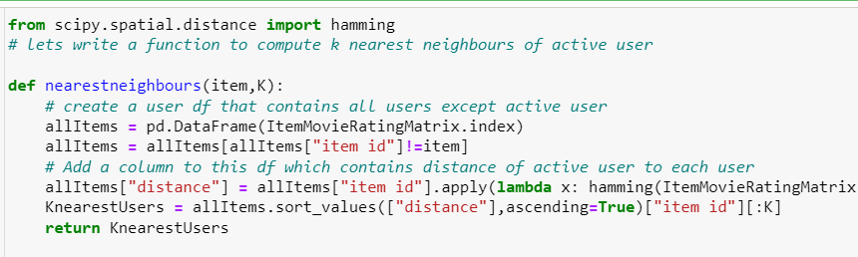
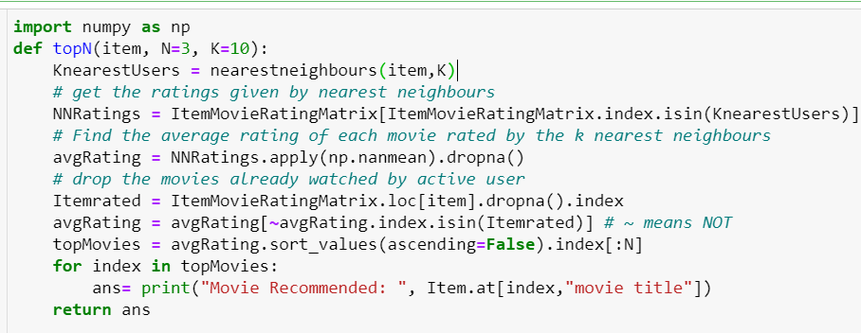
Top 5 Movies – Item Based
Movie Recommended: | Rising Sun (1993)
Movie Recommended: | Raiders of the Lost Ark (1981)
Movie Recommended: | Jack (1996)
Movie Recommended: | Red Corner (1997)
Movie Recommended: | Hellraiser: Bloodline (1996)

Slide 11
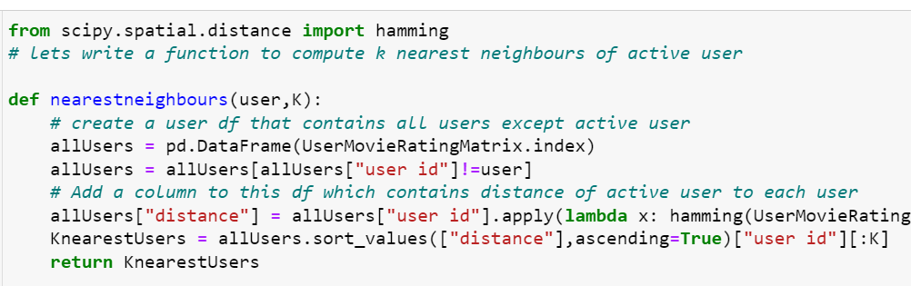
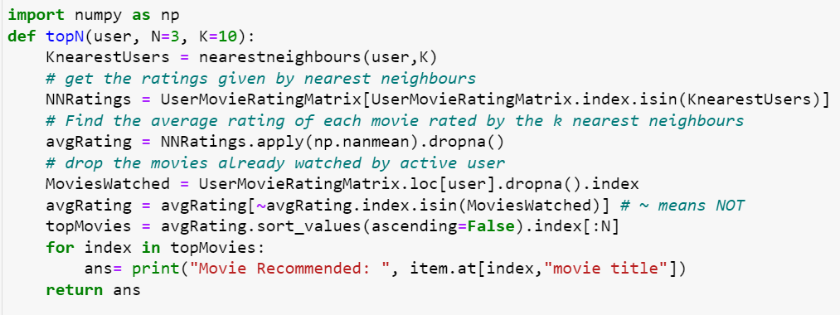
Top 5 Movies – User-Based
Movie Recommended: | Raiders of the Lost Ark (1981)
Movie Recommended: | Jury Duty (1995)
Movie Recommended: | In the Army Now (1994)
Movie Recommended: | Wrong Trousers, The (1993)
Movie Recommended: | Walk in the Clouds, A (1995)

Slide 12
MATRIX FACTORIZATION
Awesome words
MATRIX FACTORIZATION

Slide 13
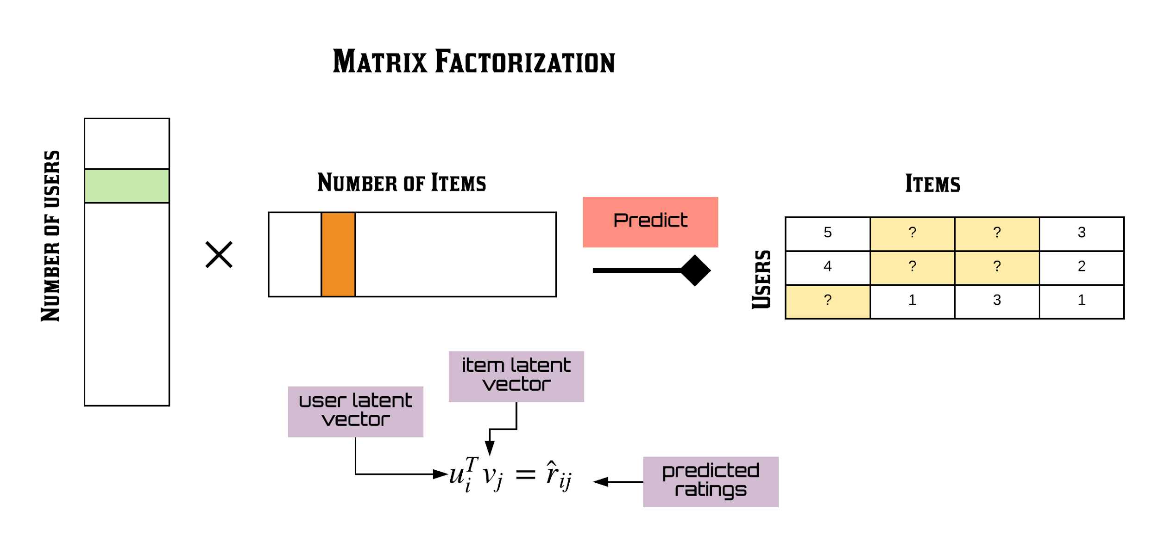
Matrix Factorization
MATRIX FACTORIZATION

Slide 14
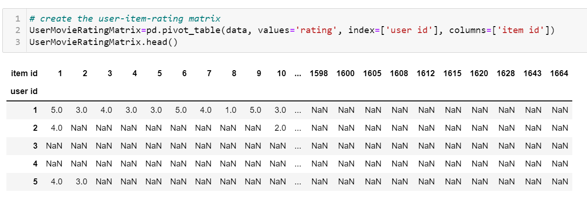
Matrix Factorization
MATRIX FACTORIZATION

Slide 15
EVALUATING
RECOMMENDATION
ENGINES
EVALUATE
RECOMMENDATION
ENGINES

Slide 16
HYBRID
RECOMMENDATION
ENGINE
Awesome words
HYBRID
RECOMMENDER
ENGINE

